Slide 1
No Quiz today!
Neural Nets Continued & Conversational Agents

Slide 2
Today’s objectives
Neural Nets for Text Generation
RNN architectures
LSTM architectures
What does text generation look like today and why?
Attention architectures
Conversational Agents

Slide 3
Recap: A standard Feed-forward Perceptron
Input
Neuron
x1
w1
x2
w2
Output
x3
w3
y( ) =
w4
x4
w5
w6
x5
x6

Slide 4
Recap: A standard Feed-forward Deep Neural Net

Slide 5
RNN: Neural Nets that have a kind of ‘memory’
The problem: we need to represent things that happen in sequence, in time, in an order.
Input = The cat chased the mouse
Bag of Words = [the, the, chased, cat, mouse]

Slide 6
RNN: Recurrent Neural Network
The main idea is that we add a feedback loop to a typical neural net architecture.
Each new input uses the weights calculated from every prior input (“memory”) along with this input’s new weights
Hidden Layers
for time step t
Hidden state _{0 … t-1}

Slide 7
RNN: Recurrent Neural Network
Neural Net t0
Time = 0
Neural Net t1
Time = 1
Neural Net t2
Time = 2
Hidden state t0
Hidden state t1
Hidden state t2
The
cat
chased
Input = The cat chased the mouse

Slide 8
The challenge of long term dependencies
Vanishing gradient: accumulating hidden state assumes that all words in the sequence are equally important, and this leads to mathematical troubles
Today, I’m a 30-year-old who wears hearing aids, never attended a residential deaf school, and who can sign proficiently, but not fluently. I attended public schools, surpassed most of my hearing peers in reading ability, graduated with a bachelor’s degree in English and a master’s degree in creative writing, married a hearing man, and work as a full-time freelance writer. Yet despite my father’s insistent confidence — “I have zero regrets,” he often tells me — I’ll never know definitively whether my parents made the right decision. - [Sarah Katz NYT]
What are some semantic dependencies in this excerpt?
What are some important words and less important words?
Notes:
Excerpt from NYT article “Is there a right way to be Deaf?” https://www.nytimes.com/2019/11/07/opinion/health/is-there-a-right-way-to-be-deaf.html?action=click&module=Opinion&pgtype=Homepage

Slide 9
Surprising gains in neural nets ‘memory’ simply by sometimes forgetting stuff

Slide 10

Dropout: discard some output to prevent overfitting
A fully connected layer: all information from the previous layer’s neurons goes to every neuron in the next layer
Output Layer
Hidden Layers
Notes:
Image source: Srivastava, Nitish, Geoffrey Hinton, Alex Krizhevsky, Ilya Sutskever, and Ruslan Salakhutdinov. "Dropout: a simple way to prevent neural networks from overfitting." The journal of machine learning research 15, no. 1 (2014): 1929-1958.

Slide 11
Dropout: discard some output to prevent overfitting
A fully connected layer: all information from the previous layer’s neurons goes to every neuron in the next layer
A dropout layer can prevent overfitting by randomly dropping information from neurons between layers
Notes:
Image source: Srivastava, Nitish, Geoffrey Hinton, Alex Krizhevsky, Ilya Sutskever, and Ruslan Salakhutdinov. "Dropout: a simple way to prevent neural networks from overfitting." The journal of machine learning research 15, no. 1 (2014): 1929-1958.

Slide 12
Dropout: discard some output to prevent overfitting
One main idea is that forgetting some things prevents potentially irrelevant information from impacting decisions, and forces the most important information to be what survives forgetting.
Notes:
Image source: Srivastava, Nitish, Geoffrey Hinton, Alex Krizhevsky, Ilya Sutskever, and Ruslan Salakhutdinov. "Dropout: a simple way to prevent neural networks from overfitting." The journal of machine learning research 15, no. 1 (2014): 1929-1958.

Slide 13
LSTM: Long Short Term Memory RNN
Intuition: we can be more careful about managing memory than the naive hidden state in an RNN that remembers everything equally
Notes:
Gate images: pintrest

Slide 14



LSTM: Long Short Term Memory RNN
LSTM adds 3 gates to manage memory
💀
💀
The Gate of Forgetting
What past hidden state is worth keeping (still relevant) or no:
(0 forget - 1 keep) * past
The Gate of Input
What past hidden state will be useful to figure out this input?
Input + (remembered past)
The Gate of Output
What out of past state + this current input will be useful later?
Notes:
Gate images: pintrest

Slide 15
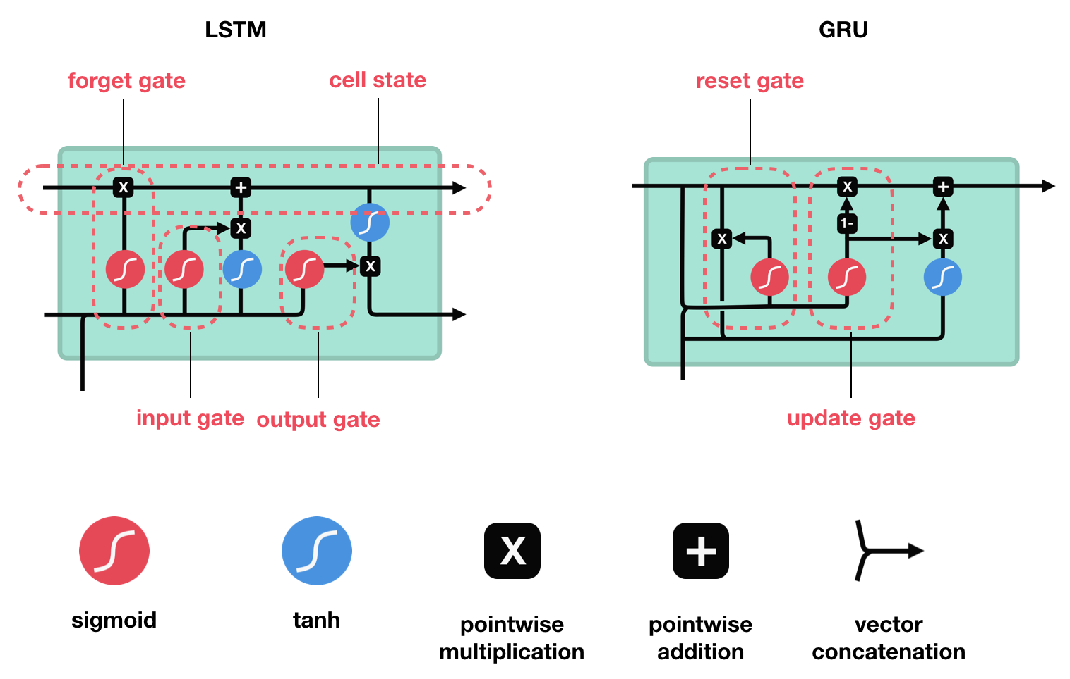
LSTM model (a neuron is now called a cell)
LSTM also adds a long term memory (cell state) to complement a more short term memory (hidden state).
Prior cell state
*New* Cell state
Prior hidden state
*New* hidden state
New input

Slide 16
How well does this perform?

Slide 17

Fun with RNNs / LSTMs (2016)
“Sunspring” is a short film who’s script was written by an LSTM. What do you notice about the story structure?

Slide 18
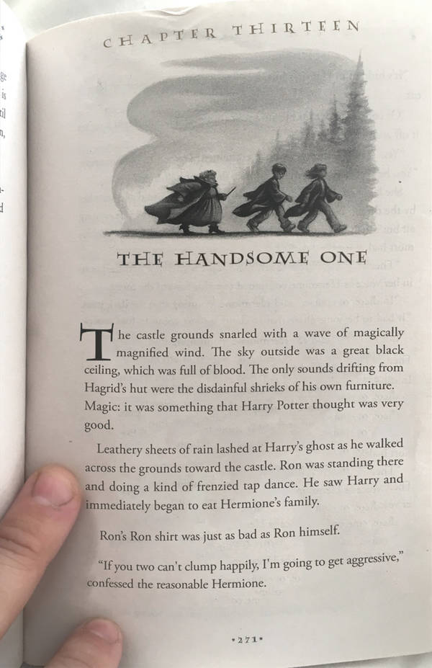
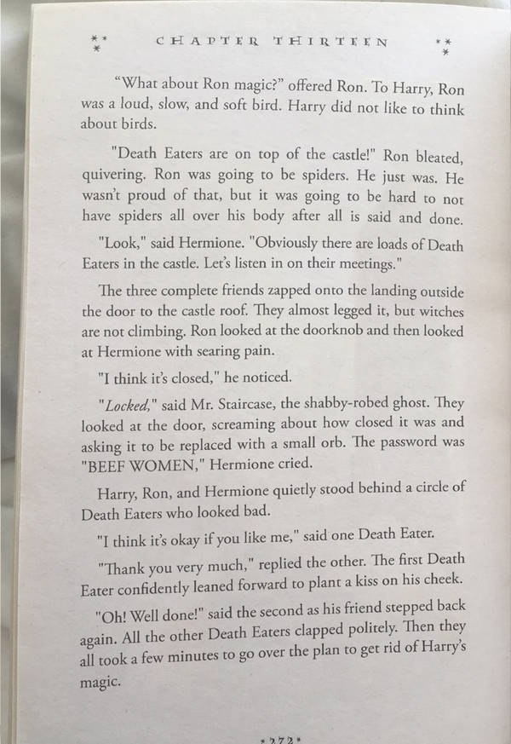
Fun with RNNs (2017)
A Harry Potter fan fiction written by an RNN.
What do you notice about the dialogue?
https://botnik.org/content/harry-potter.html

Slide 19

Memory and attention
What are some things this voice agent (HAL) is able to do that our voice agents are not able to do today?
2001: A Space Odyssey

Slide 20
In recalling sequences, what information do you pay attention to?

Slide 21
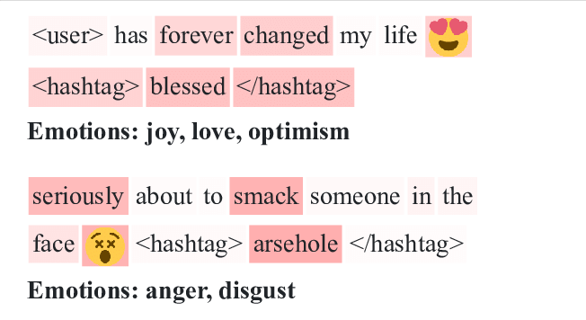
Neural Nets with Attention
Like in this heatmap visualization, “Attention” is a technique that can be used to see what words in a sequence the model pays the most attention to make its prediction.
Shown is sentiment analysis for two Tweets.

Slide 22
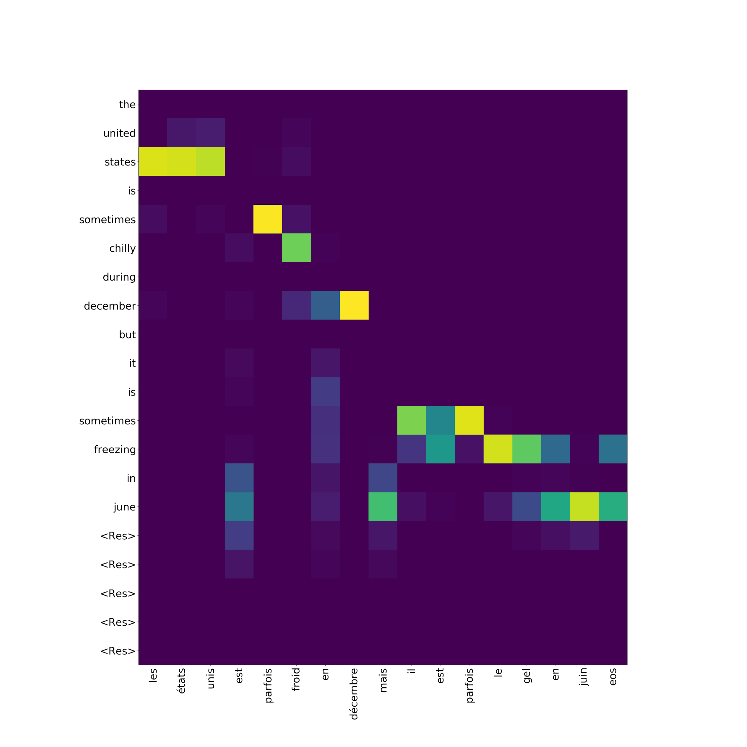
Neural Nets with Attention
Like in this heatmap visualization, “Attention” is a technique that can be used to see what words in a sequence the model pays the most attention to make its prediction.
Shown is attention for translating a phrase from english to french

Slide 23
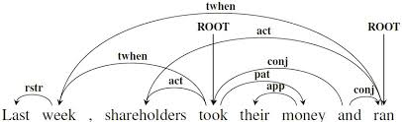
Transformers: Neural Nets with Attention (2019)
Intuition: aggregating hidden state across long sequences can’t account for long spaced out dependencies. So, instead we should pass the hidden state after each word, and use attention to figure out which ‘chunk’ of history is most important at any given point.
A dependency graph showing complex relations in a short sentence
Notes:
Image: https://skymind.ai/wiki/attention-mechanism-memory-network

Slide 24
Fun with Transformers (2019)
Input = “Ollie liked to snooze.”
Ollie liked to snooze. And that is exactly what he did for the last thirty years of his life. I suppose you could argue that he should have been able to sleep better because he didn't wake up so much. But let's not put the blame on the poor man. He didn't have a lot of people to talk to about it all. He didn't have the benefit of books. He didn't have the benefit of a large extended family to support him. He wasn't even married. His entire life was about him.
A text model based on a model released by OpenAI in early 2019. What do you think of the quality?
https://talktotransformer.com/

Slide 25
Conversational Agents: reading discussion

